Slide 1
Date: 25 November 2025

Slide 2
Weekly Presentation : Rotor Bearing System
Week number: 09
Date: 25 /11/2025
Supervisor: Prof. Peter Quell
Group members: Divyesh Mistry, Venkata Sreekanth .K , Sreehari Padachery, Jill Sadariya
Presenter : Sreehari Padachery

Slide 3
Agenda
Bearing Housing.
Rotor Lock.
Rotor Lock pin Calculations.
Rotor Lock Disc Calculations.
Shaft Flange.
Task Performed up to now
Bibliography.

Slide 4
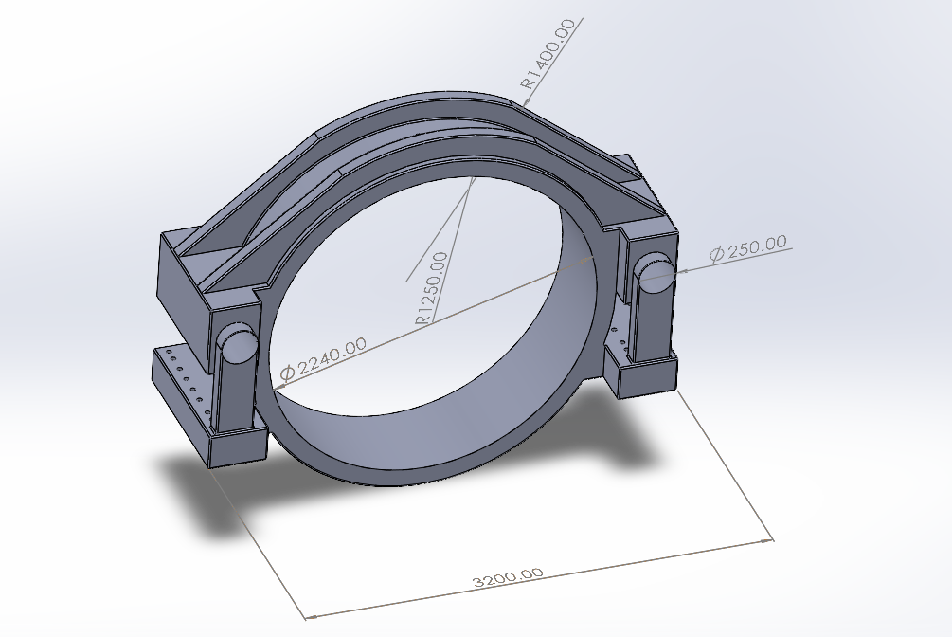
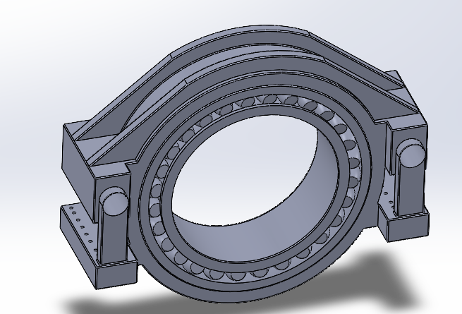
Bearing Housing
parameter | value
OD | 2500mm
Rib radius | 1400mm
ID/Bore dia | 2240mm
Width | 630mm
Total length | 3200mm

Slide 5
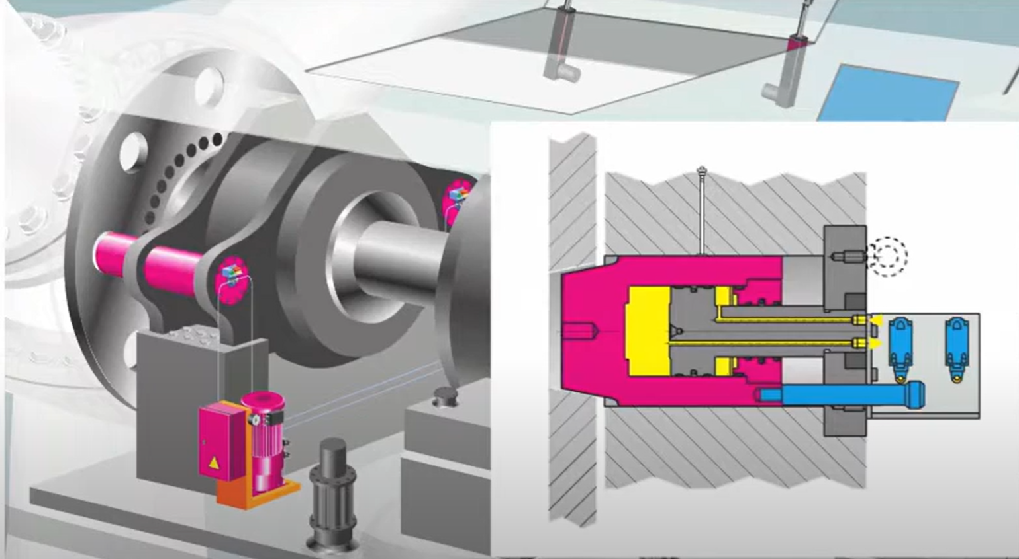
Rotor Lock
The ROEMHELD rotor lock works with hydraulic or electromechanical locking mechanism and withstands side loads up to 5,500 kN.
Temperature range from – 30°C to + 70 °C.
Source: ROEMHELD

Slide 6
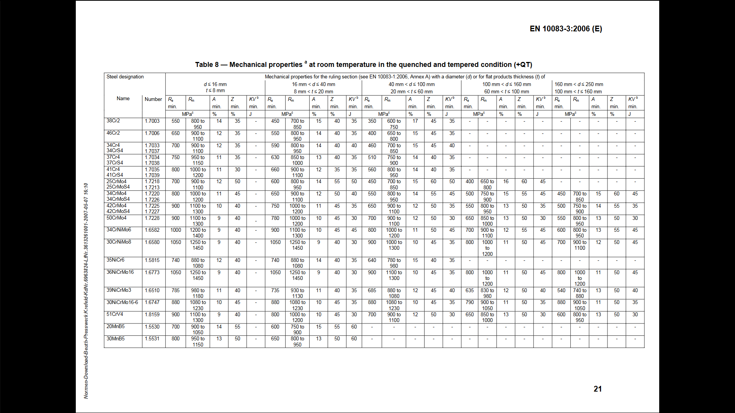
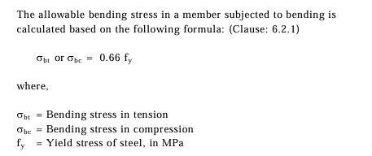
Rotor Lock pin Calculations
Allowable bending stress of the steel material = 0.66f_{y} (As per Steel Design Indian Standard (IS) 800, American Institute of Steel Construction (AISC) ASD 9th Edition
From DIN EN 10083-3,Table 8
Where Yield strength of the material 30NiCrMo16-6 , fy = 880 MPa or 880 N/mm²
Allowable bending stress of the material 30NiCrMo16-6 = 0.66* 880
=580.8 N/mm²

Slide 7
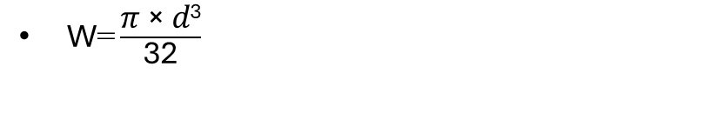

Rotor Lock pin Calculations
$\text{σ} \text{=}\frac{\text{M} \text{b}\text{,}\text{pin}}{\text{W}} =\text{580.8 }\text{N}\text{/}\text{mm}\text{2}$
$\text{W}\text{=}\frac{\text{606314.7 }\text{KNmm}}{\text{580.8 }\text{N}\text{/}\text{mm}\text{2}}$==1043930.268
$\text{W}\text{=}\frac{\text{π}\text{ × }\text{d}\text{3}}{\text{32}}$
D= D₁ = 219.9 = 220 mm
Length of Lock pin L1+L2 = 930 mm
D₂ = 220-30=190mm
L₂= 15mm
L2
D1
D2
L1

Slide 8
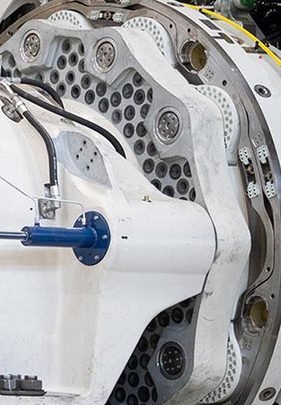



Rotor Lock Disc Calculations
$\text{F} \text{=}\frac{\text{M}T}{\text{2∗}\text{r}}$
where, Lock pin hole circle radius r = 1425mm
As per Prof. Peter Quell the load case with Maximum Torque of 2.5*M_{XR rated} = 12800KNm
Thickness
$\text{F} \text{= 4491.22 }\text{KN}$
Bending Moment acting on the Lock pin , M_{bpin=}F*L
$\text{L} \text{=}\frac{Thickness}{\text{2}}+10mm clearance$
( From Optimus Shakti and 60 E)
Thickness =Thickness of Flange+ Width of Lock disc = 150+100= 250 mm
$\text{L} \text{=}\frac{250}{\text{2}}+10mm clearance=135mm$
M_{bpin=}F*L= 606314.7 KNmm
Source: Machinery Components, Prof. Peter Quell

Slide 9
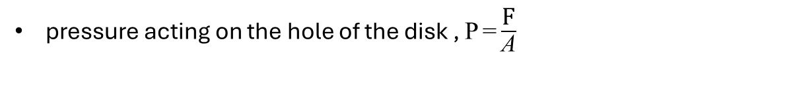
Rotor Lock Disc Calculations
pressure acting on the hole of the disk , $\text{P} \text{=}\frac{\text{F}}{\text{A}}$
The disk hole = Diameter of lock pin +3mm = 220+3= 223 mm
Pressure acting area of the hole, A=223*135=30105 mm²
$\text{P} \text{=}\frac{\text{F}}{\text{A}}=\frac{\text{4491.22 }\text{KN}}{\text{30105 }mm2}=149.18 N/\text{mm}\text{2}$

Slide 10
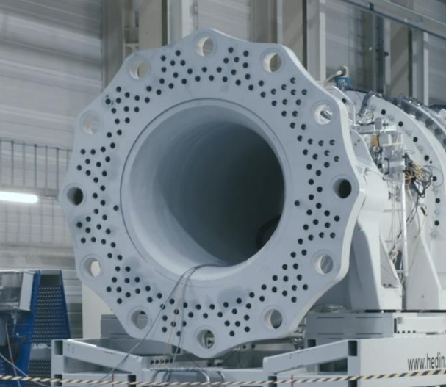
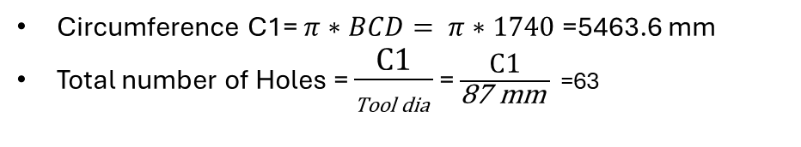
Shaft Flange
Description | Symbol | Value | Unit
Outer screw circle diameter | dt2 | 1900 | mm
Inner screw circle diameter | dt1 | 1740 | mm
No. of screws per bolt circle diameter | N_{total} = N_{ICB} + N_{OCB} | 63+68=131
Hole dia for M36 bolts = 39 mm (36+3mm)
Rotor lock hole circle diameter = 2850 mm (Assumed based on feed back drawing)
Flange outer dia = 2850 +50 = 2900mm
e
Circumference C1= $π∗BCD= π∗1740$ =5463.6 mm
Total number of Holes = $\frac{\text{C}\text{1}}{\text{Tool} \text{dia} }$ = $\frac{\text{C}\text{1}}{\text{87 }\text{mm} }$ =63
Source: Machinery Components, Prof. Peter Quell

Slide 11
Task Performed up to now
Group Members | Components
Divyesh Mistry & Venkata Sreekanth.k | Rotor Shaft
Sreehari Padachery & Jill Sadariya | Spherical Roller Bearing
Sreehari Padachery& Jill Sadariya | Rotor Lock Pin
Venkata Sreekanth.k& Divyesh Mistry | Rotor Lock Disc
Sreehari Padachery | Bearing Housing

Slide 12
Bibliography – Rotor Bearing System
SKF. (n.d.). 240/1120 CAF/W33 - Spherical roller bearings. Retrieved October 29, 2025, from https://www.skf.com/group/products/rolling-bearings/roller-bearings/spherical-roller-bearings/productid-240%2F1120 CAF%2FW33
Optimus Shakti, Optimus 60E
ITH. (n.d.). ITH Hydraulic Torque Wrenches Catalog. Retrieved November 08, 2025, from www.ITH.de/schraubwerkzeuge/hydraulische-drehmomentschrauber
Römheld GmbH Friedrichshütte. (n.d.). Rotorlock. Retrieved November 24, 2025, from https://www.rotorlock.de/en
Machinery Components, Prof. Peter Quell
DIN EN 10083-3: Steels for quenching and tempering – Part 3: Technical delivery conditions for alloy steels. Retrieved November 22, 2025, from https://studylib.net/doc/18166049/din-en-10083-steel-for-quenching-and-tempering-part-3-
American Institute of Steel Construction. (1989). Manual of Steel Construction: Allowable Stress Design (9th ed.). Chicago, IL: Author. Retrieved November 22, 2025, from Internet Archive (Manual of Steel Construction: Allowable Stress Design, 9th Edition)
Bureau of Indian Standards. (2007). IS 800: General Construction in Steel—Code of Practice (Third Revision). New Delhi: Bureau of Indian Standards. Retrieved November 22, 2025, from Internet Archive (IS 800: General Construction in Steel - Code of Practice)

